Slide 1
Entity-Relationship Model
Tanvir Ahmed

Slide 2
Entity-Relationship Model
Design Process
Modeling
Constraints
E-R Diagram
Design Issues
Weak Entity Sets
Extended E-R Features
Design of the Bank Database
Reduction to Relation Schemas
Database Design
Tanvir Ahmed

Slide 3
Modeling
A database can be modeled as:
  a collection of entities,
  relationship among entities.
An entity is an object that exists and is distinguishable from other objects.
  Example: specific person, company, event, plant
Entities have attributes
  Example: people have names and addresses
An entity set is a set of entities of the same type that share the same properties.
  Example: set of all persons, companies, trees, holidays
Tanvir Ahmed

Slide 4
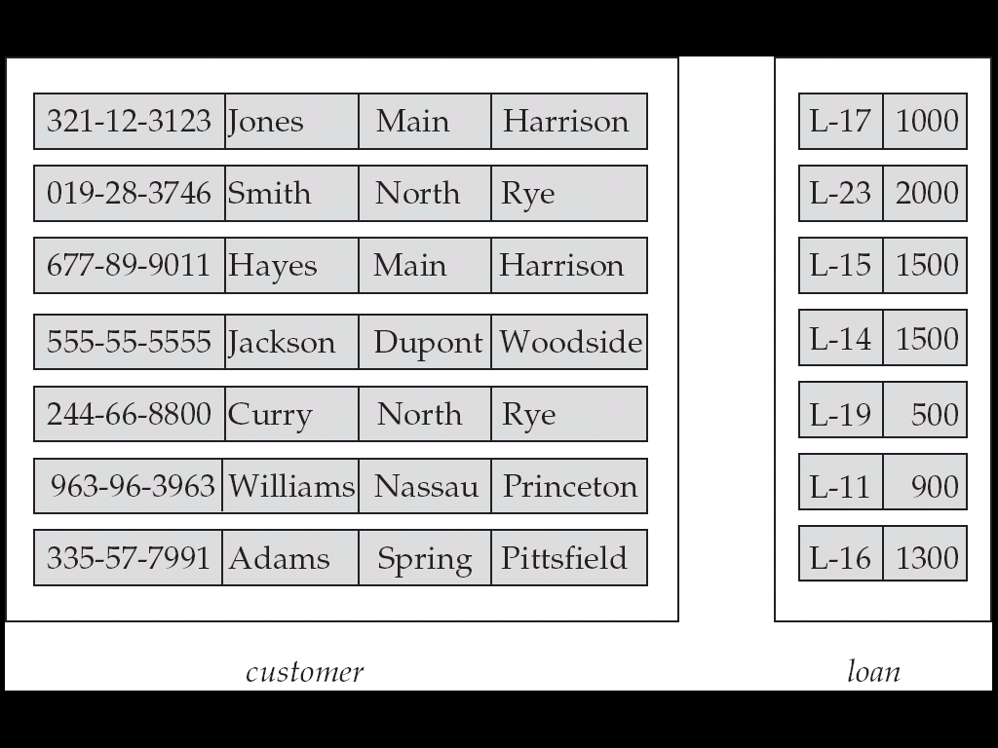
Entity Sets customer and loan
customer_id customer_ customer_ customer_ loan_ amount
name street city number
Tanvir Ahmed

Slide 5
Relationship Sets
A relationship is an association among several entities
Example:
Hayes depositor A-102
customer entity relationship set account entity
A relationship set is a mathematical relation among n ≥ 2 entities, each taken from entity sets
{(e₁, e₂, … e_{n}) | e₁ ∈ E₁, e₂ ∈ E₂, …, e_{n} ∈ E_{n}}
where (e₁, e₂, …, e_{n}) is a relationship
  Example:
  (Hayes, A-102) ∈ depositor
Tanvir Ahmed

Slide 6
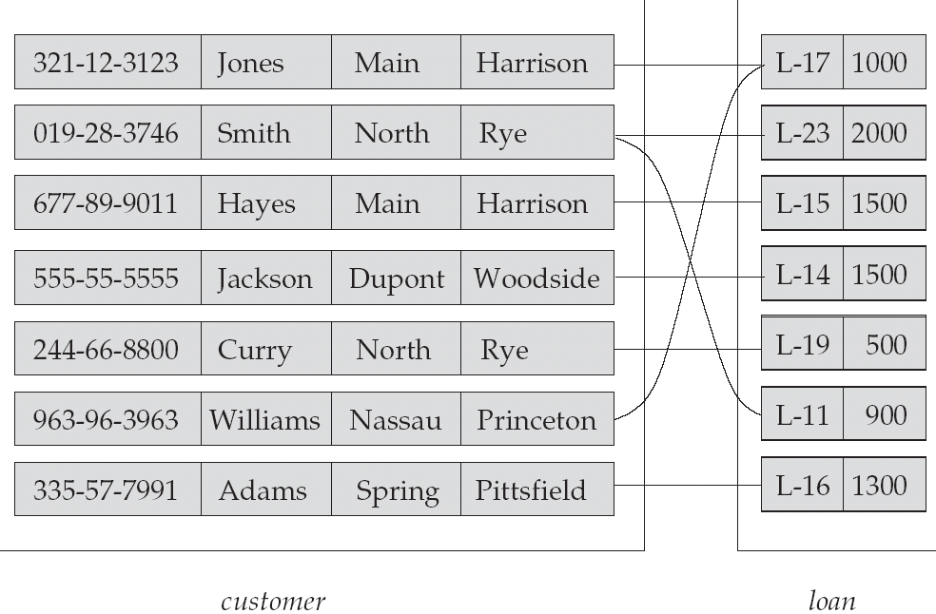
Relationship Set borrower
Tanvir Ahmed

Slide 7
ER Model Basics
name
ssn
lot
Employees
Entity: Real-world object distinguishable from other objects. An entity is described (in DB) using a set of attributes.
Entity Set: A collection of similar entities. E.g., all employees.
  All entities in an entity set have the same set of attributes. (Until we consider ISA hierarchies, anyway!)
  Each entity set has a key.
  Each attribute has a domain.
Notes:
3
The slides for this text are organized into several modules. Each lecture contains about enough material for a 1.25 hour class period. (The time estimate is very approximate--it will vary with the instructor, and lectures also differ in length; so use this as a rough guideline.) This covers Lectures 1 and 2 (of 6) in Module (5).
Module (1): Introduction (DBMS, Relational Model)
Module (2): Storage and File Organizations (Disks, Buffering, Indexes)
Module (3): Database Concepts (Relational Queries, DDL/ICs, Views and Security)
Module (4): Relational Implementation (Query Evaluation, Optimization)
Module (5): Database Design (ER Model, Normalization, Physical Design, Tuning)
Module (6): Transaction Processing (Concurrency Control, Recovery)
Module (7): Advanced Topics

Slide 8
E-R Model Constructs
Entity instance - person, place, object, event, concept (often corresponds to a row in a table)
  Entity Type – collection of entities (often corresponds to a table)
Attribute - property or characteristic of an entity type (often corresponds to a field in a table)
Relationship instance – link between entities (corresponds to primary key-foreign key equivalencies in related tables)
  Relationship type – category of relationship…link between entity types
Tanvir Ahmed
Notes:
2

Slide 9
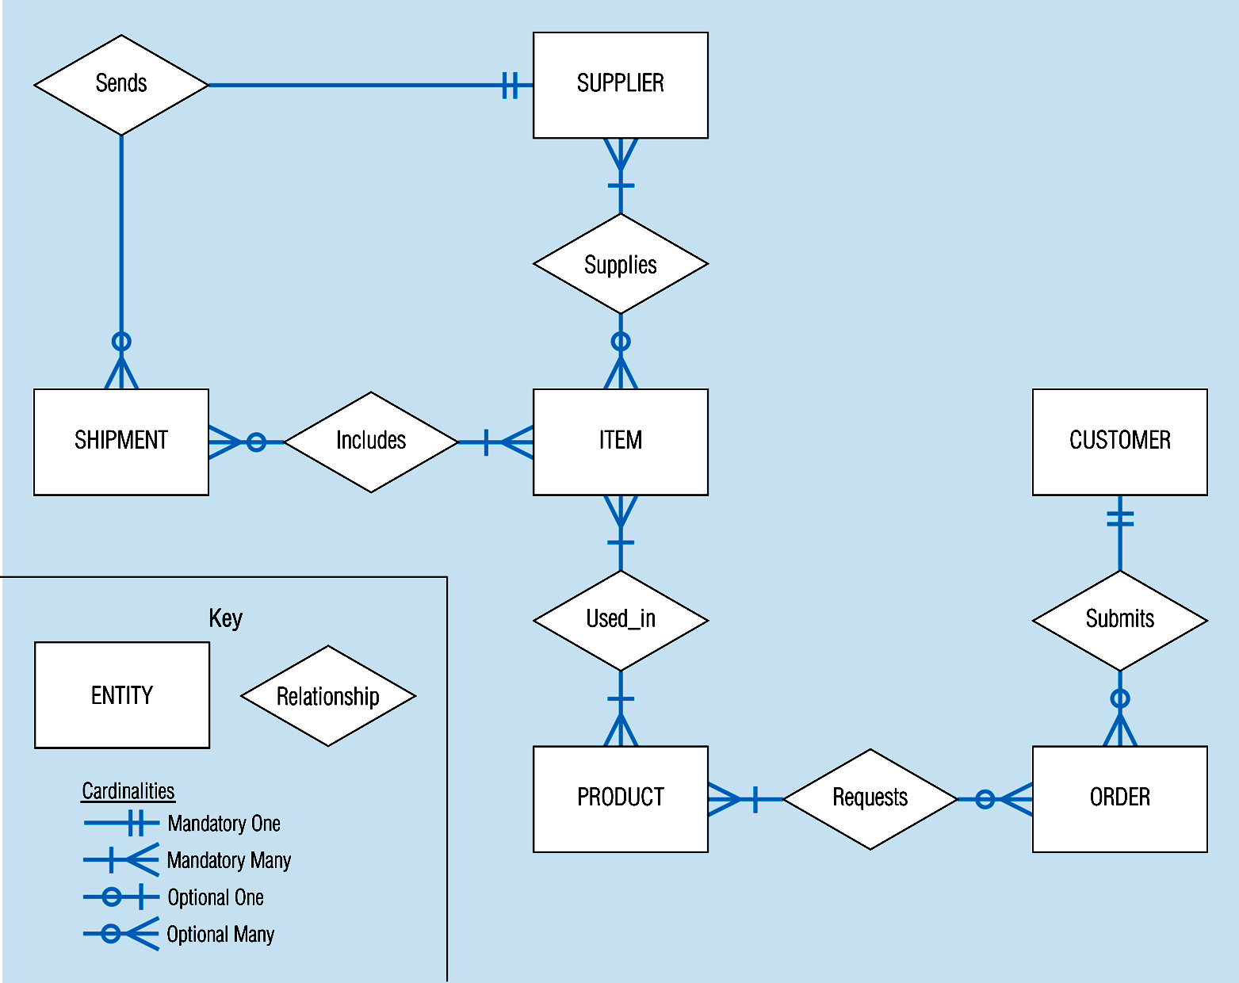
Sample E-R Diagram (figure 3-1)
Tanvir Ahmed
Notes:
3

Slide 10
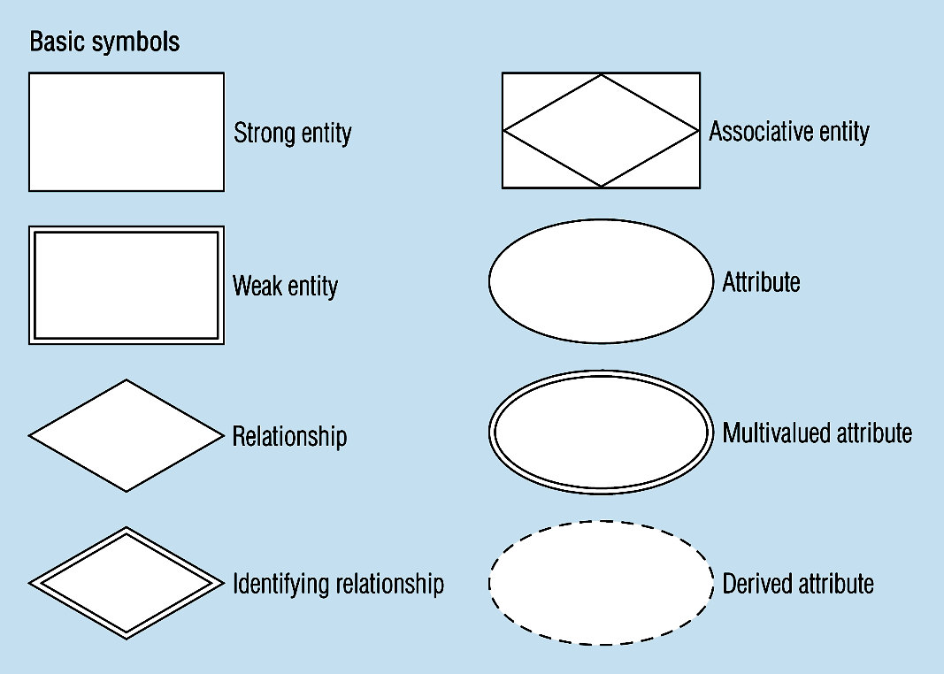
Figure 3-2 -- Basic E-R Notation
A special entity that is also a relationship
Entity symbols
Attribute symbols
Relationship symbols
Tanvir Ahmed
Notes:
8

Slide 11
What Should an Entity Be?
SHOULD BE:
  An object that will have many instances in the database
  An object that will be composed of multiple attributes
  An object that we are trying to model
SHOULD NOT BE:
  A user of the database system
  An output of the database system (e.g. a report)
Tanvir Ahmed

Slide 12
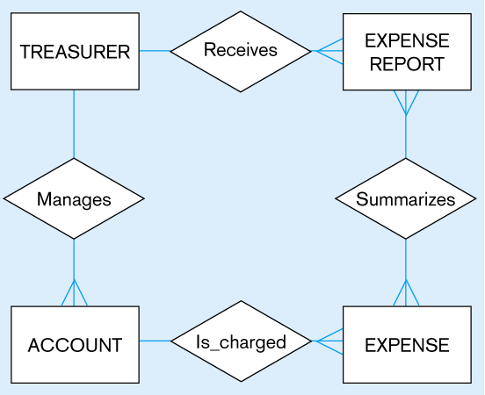
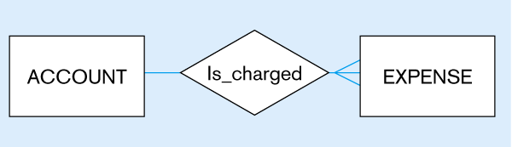
Figure 3-4
Inappropriate entities
System user
System output
Appropriate entities
Tanvir Ahmed

Slide 13
Attributes
Attribute - property or characteristic of an entity type
Classifications of attributes:
  Simple versus and Composite Attribute
  Single-Valued and Multivalued Attribute
  Derived Attributes
Tanvir Ahmed
Notes:
5

Slide 14
Attributes
An entity is represented by a set of attributes, that is descriptive properties possessed by all members of an entity set.
Domain – the set of permitted values for each attribute
Attribute types:
  Simple and composite attributes.
  Single-valued and multi-valued attributes
    Example: multivalued attribute: phone_numbers
  Derived attributes
    Can be computed from other attributes
    Example: age, given date_of_birth
Example:
customer = (customer_id, customer_name, customer_street, customer_city )
loan = (loan_number, amount )
Tanvir Ahmed

Slide 15
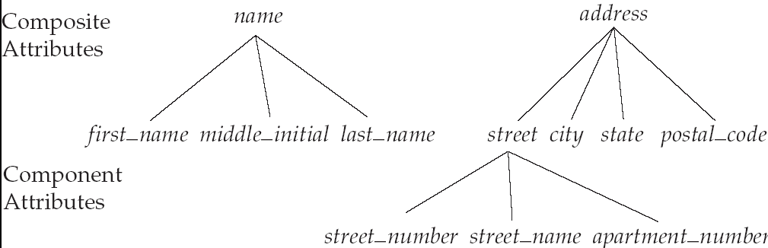
Composite Attributes
Tanvir Ahmed

Slide 16
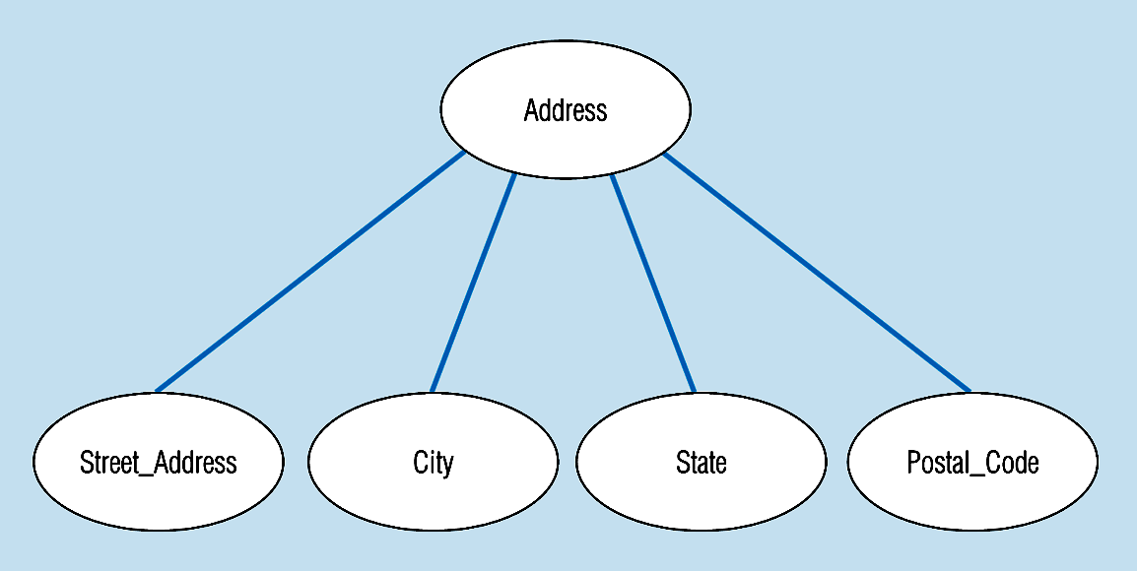
Figure 3-7 -- A composite attribute
An attribute broken into component parts
Tanvir Ahmed
Notes:
12

Slide 17

Figure 3-9a – Simple key attribute
The key is underlined
Tanvir Ahmed
Notes:
14

Slide 18
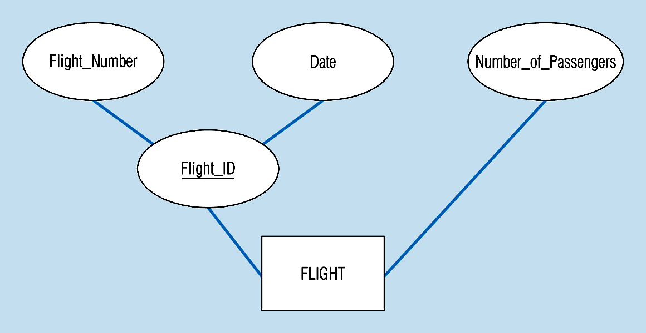
Figure 3-9b -- Composite key attribute
The key is composed
of two subparts
Tanvir Ahmed
Notes:
15

Slide 19
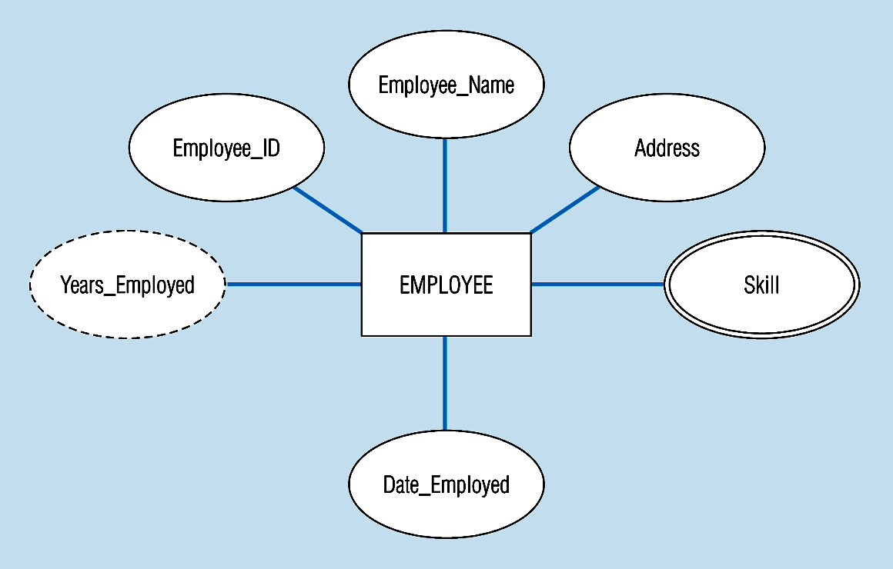
Figure 3-8 -- Entity with a multivalued attribute (Skill) and derived attribute (Years_Employed)
What’s wrong with this?
Multivalued:
an employee can have
more than one skill
Derived
from date employed and current date
Tanvir Ahmed
Notes:
13

Slide 20
Degree of Relationships
Degree of a Relationship is the number of entity types that participate in it
  Unary Relationship
  Binary Relationship
  Ternary Relationship
Tanvir Ahmed
Notes:
16

Slide 21
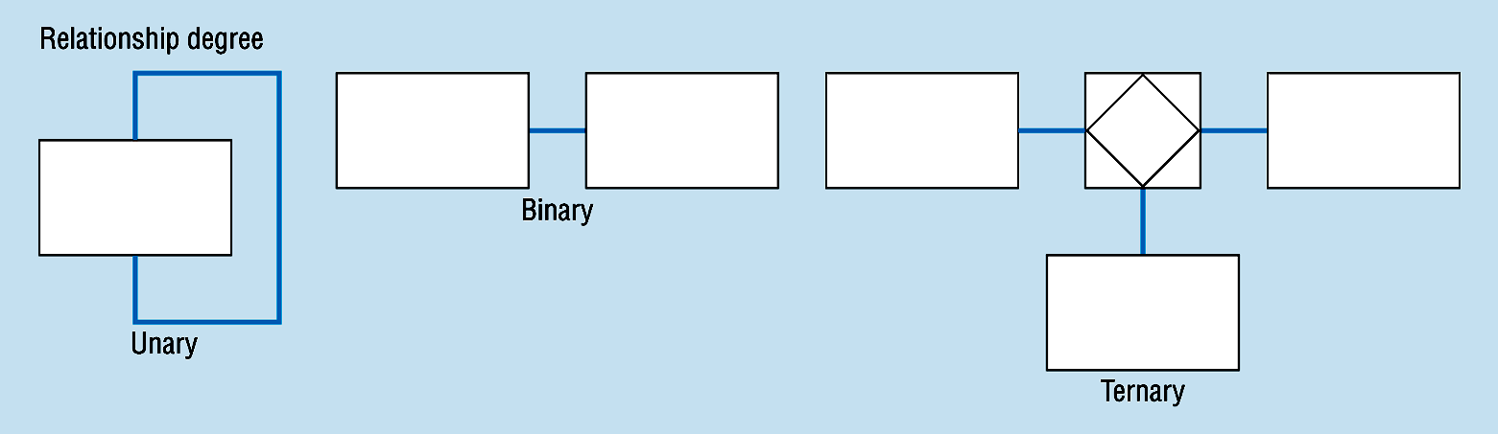
Degree of relationships – from figure 3-2
One entity related to another of the same entity type
Entities of two different types related to each other
Entities of three different types related to each other
Tanvir Ahmed
Notes:
8

Slide 22
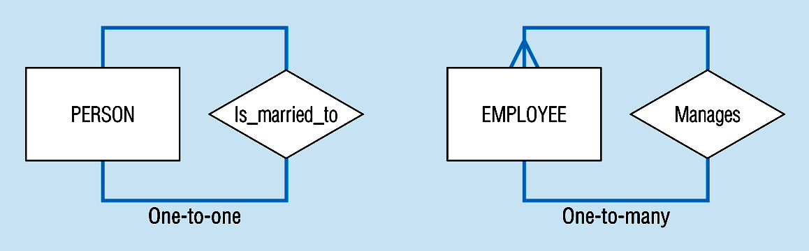
Unary relationships -- figure 3-12a
Tanvir Ahmed
Notes:
22

Slide 23
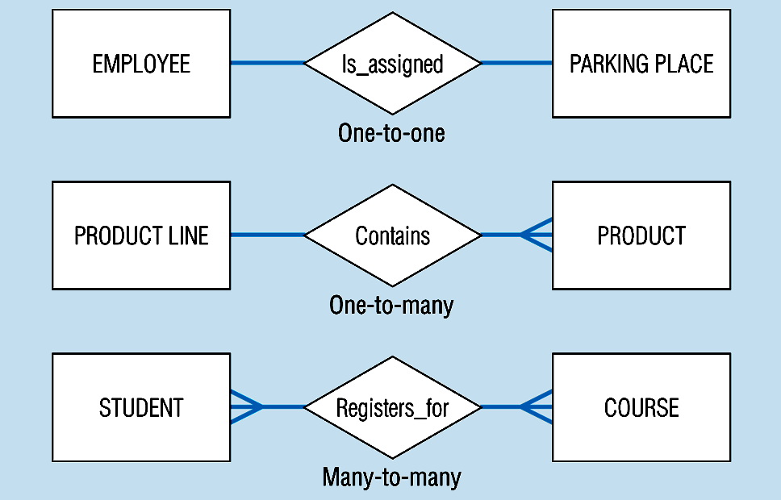
Binary relationships – figure 3-12b
Tanvir Ahmed
Notes:
23

Slide 24
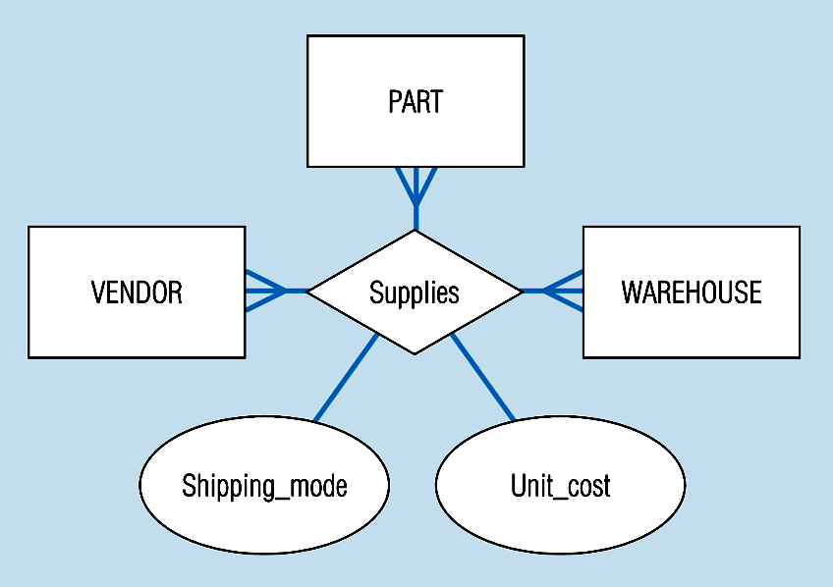
Ternary relationships –figure 3-12c
Note: a relationship can have attributes of its own
Tanvir Ahmed
Notes:
24

Slide 25
Cardinality Constraints
Cardinality Constraints - the number of instances of one entity that can or must be associated with each instance of another entity.
Tanvir Ahmed
Notes:
29

Slide 26
Cardinality of Relationships
One – to – One
  Each entity in the relationship will have exactly one related entity
One – to – Many
  An entity on one side of the relationship can have many related entities, but an entity on the other side will have a maximum of one related entity
Many – to – Many
  Entities on both sides of the relationship can have many related entities on the other side
Tanvir Ahmed

Slide 27
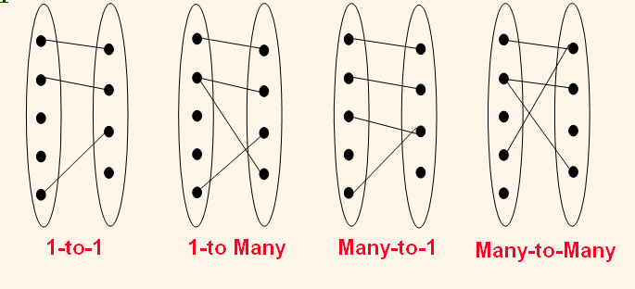

Tanvir Ahmed

Slide 28

One-To-Many Relationship
In the one-to-many relationship a loan is associated with at most one customer via borrower, a customer is associated with several (including 0) loans via borrower
Tanvir Ahmed

Slide 29
Many-To-One Relationships
In a many-to-one relationship a loan is associated with several (including 0) customers via borrower, a customer is associated with at most one loan via borrower
Tanvir Ahmed

Slide 30

Many-To-Many Relationship
A customer is associated with several (possibly 0) loans via borrower
A loan is associated with several (possibly 0) customers via borrower
Tanvir Ahmed

Slide 31
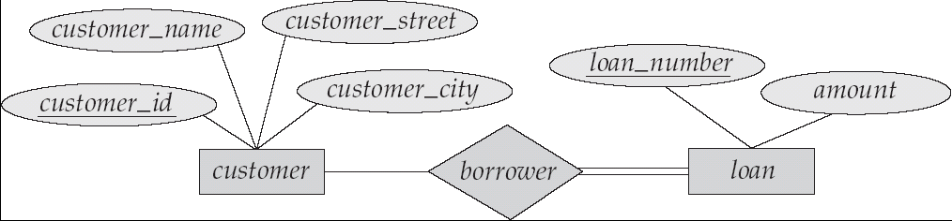
Participation of an Entity Set in a Relationship Set
Total participation (indicated by double line): every entity in the entity set participates in at least one relationship in the relationship set
  E.g. participation of loan in borrower is total
    every loan must have a customer associated to it via borrower
Partial participation: some entities may not participate in any relationship in the relationship set
  Example: participation of customer in borrower is partial
Tanvir Ahmed

Slide 32
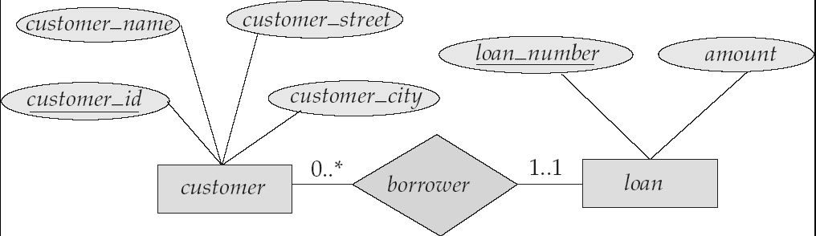
Alternative Notation for Cardinality Limits
Cardinality limits can also express participation constraints
Tanvir Ahmed

Slide 33
Participation Constraints
Does every department have a manager?
  If so, this is a participation constraint: the participation of Departments in Manages is said to be total (vs. partial).
    Every Departments entity must appear in an instance of the Manages relationship.
since
since
name
name
dname
dname
ssn
did
did
budget
lot
budget
Employees
Manages
Departments
Works_In
since
Notes:
8

Slide 34
Weak Entities
A weak entity can be identified uniquely only by considering the primary key of another (owner) entity.
  Owner entity set and weak entity set must participate in a one-to-many relationship set (one owner, many weak entities).
  Weak entity set must have total participation in this identifying relationship set.
name
ssn
lot
cost
pname
age
Employees
Policy
Dependents
Notes:
10

Slide 35
Strong vs. Weak Entities, and
Identifying Relationships
Strong entities
  exist independently of other types of entities
  has its own unique identifier
  represented with single-line rectangle
Weak entity
  dependent on a strong entity…cannot exist on its own
  Does not have a unique identifier
  represented with double-line rectangle
Identifying relationship
  links strong entities to weak entities
  represented with double line diamond
Tanvir Ahmed

Slide 36
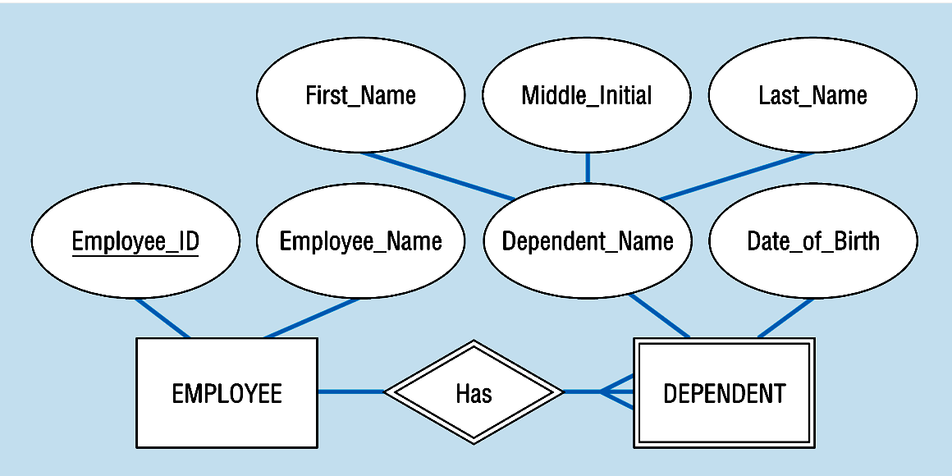
Figure 3-5: Strong and weak entities
Strong entity
Identifying relationship
Weak entity
Tanvir Ahmed

Slide 37
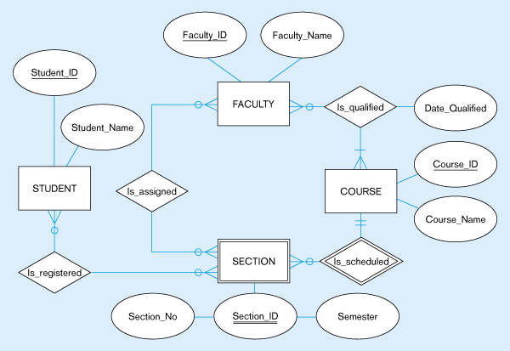
Figure 4-16 – Data model segment for class scheduling
Tanvir Ahmed

Slide 38
ISA (`is a’) Hierarchies
name
ssn
lot
Employees
As in C++, or other PLs, attributes are inherited.
If we declare A ISA B, every A entity is also considered to be a B entity.
hours_worked
hourly_wages
ISA
contractid
Hourly_Emps
Contract_Emps
Reasons for using ISA:
  To add descriptive attributes specific to a subclass.
  To identify entitities that participate in a relationship.
Notes:
12

Slide 39
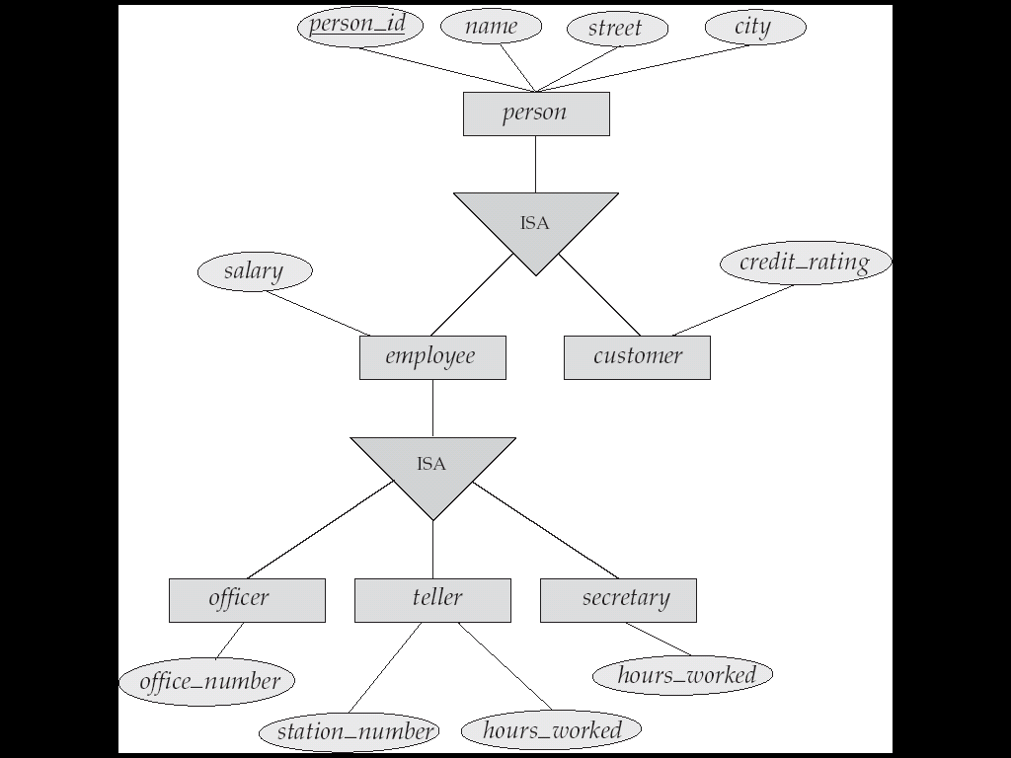
Specialization Example
Tanvir Ahmed

Slide 40
Aggregation
name
ssn
lot
Used when we have to model a relationship involving (entitity sets and) a relationship set.
  Aggregation allows us to treat a relationship set as an entity set for purposes of participation in (other) relationships.
Employees
Monitors
until
dname
since
pname
did
pid
pbudget
Departments
Sponsors
Projects
Notes:
2

Slide 41
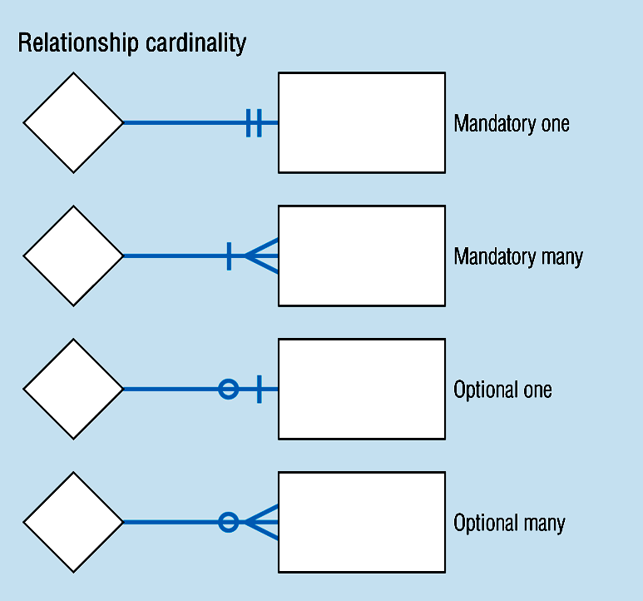
Cardinality – figure 3-2
Tanvir Ahmed
Notes:
8

Slide 42
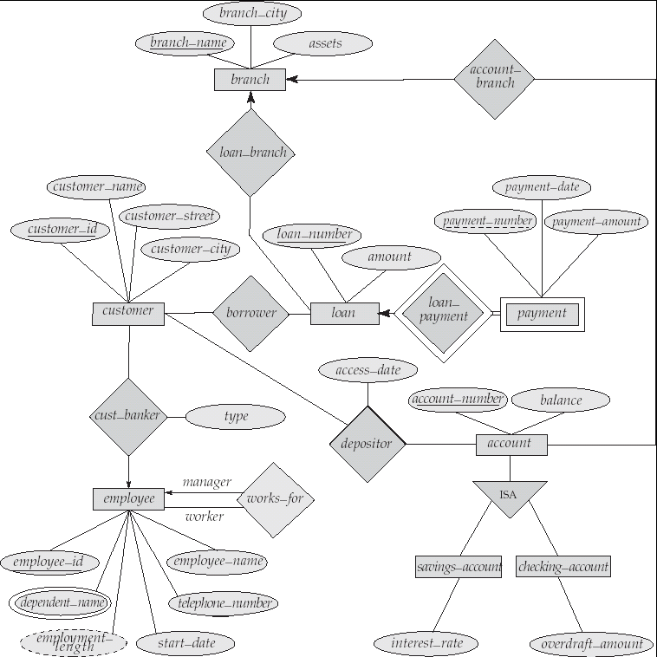
E-R Diagram for a Banking Enterprise
Tanvir Ahmed

Slide 43
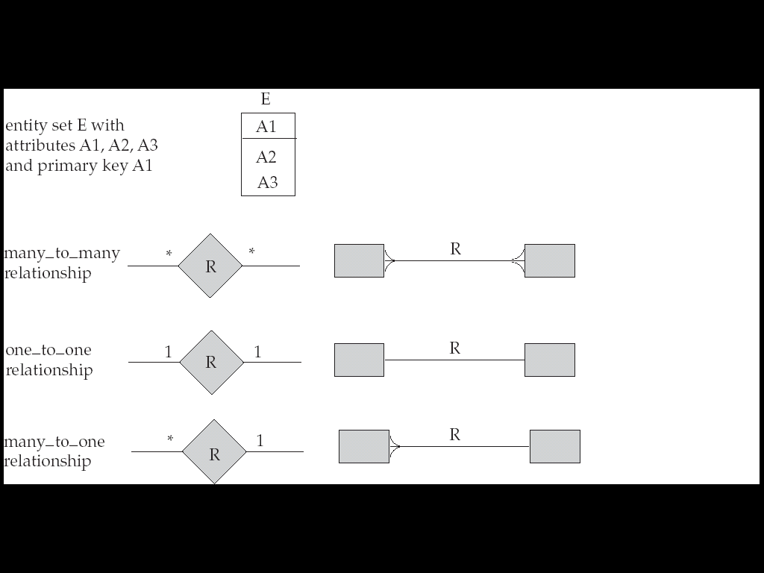
Summary of Symbols (Cont.)
Tanvir Ahmed

Slide 44
Tanvir Ahmed

